Slide 1
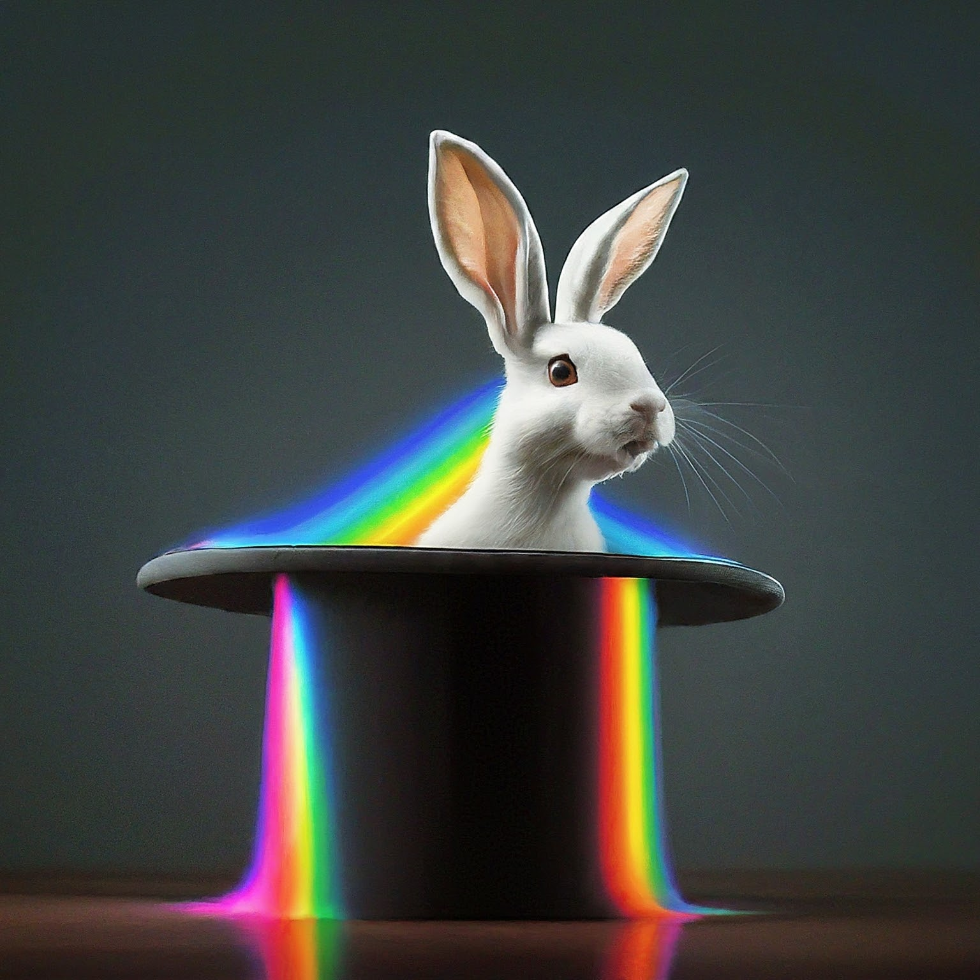



Unmixing: It’s not magic!
By David Rach
Molecular Microbiology and Immunology PhD Candidate
University of Maryland, Baltimore
April 23rd, 2024
Generated by David Rach with Bard, a large language model from Google AI.
Prompt: Cartoon rabbit with rainbow fluorescent spectra.
Unmixing: It's not magic! © 2025 by David Rach
is licensed under CC BY-SA 4.0

Slide 2
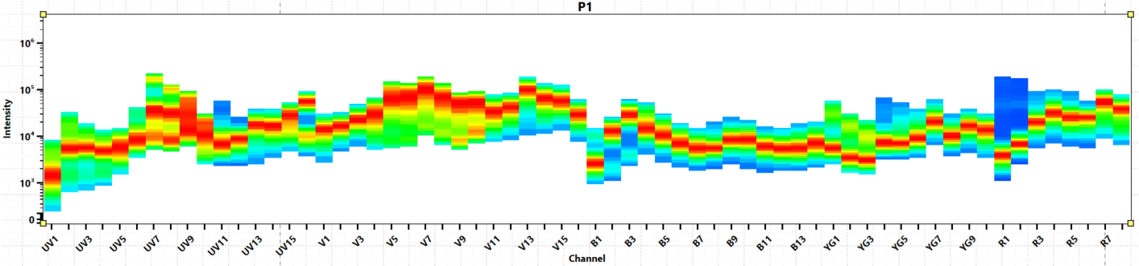





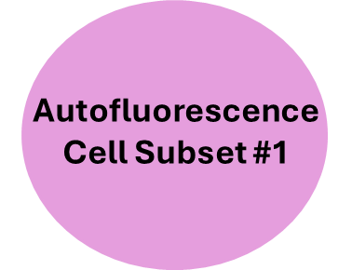
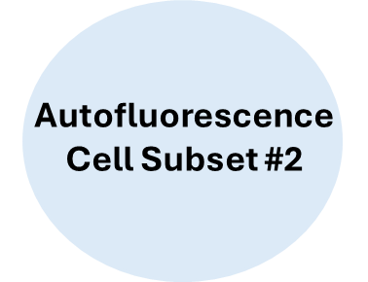
A spectral cytometer needs three things
for successful unmixing:
Full-stained Samples
Single-color
Reference Controls
Unstained
Reference Controls

Slide 3
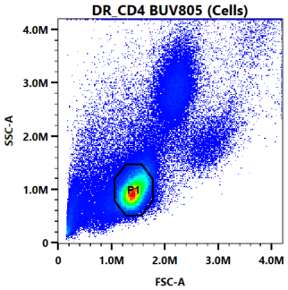
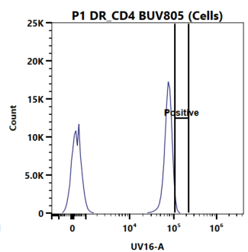
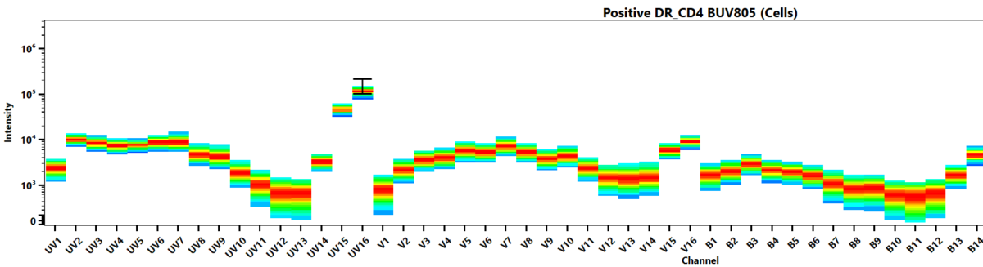
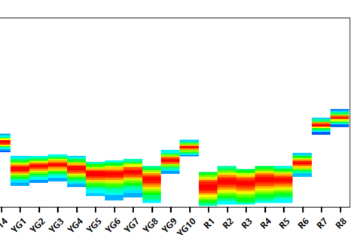
The Unmixing Screen:

Slide 4
The Unmixing Screen:
What if I grabbed the entire peak?
What if I gated like this?
What does this even do again!?!?!?
What if I set it on the adjacent detector?

Slide 5
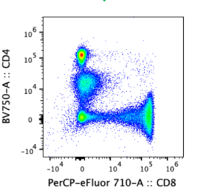
Rationale:
1) Raw Data
2) ???
3) Unmixed Data
Something something
least squares

Slide 6
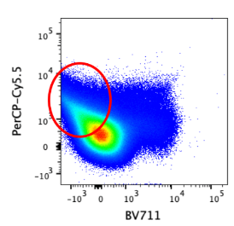
Rationale:
1) Raw Data
2) ???
Something something
least squares

Slide 7
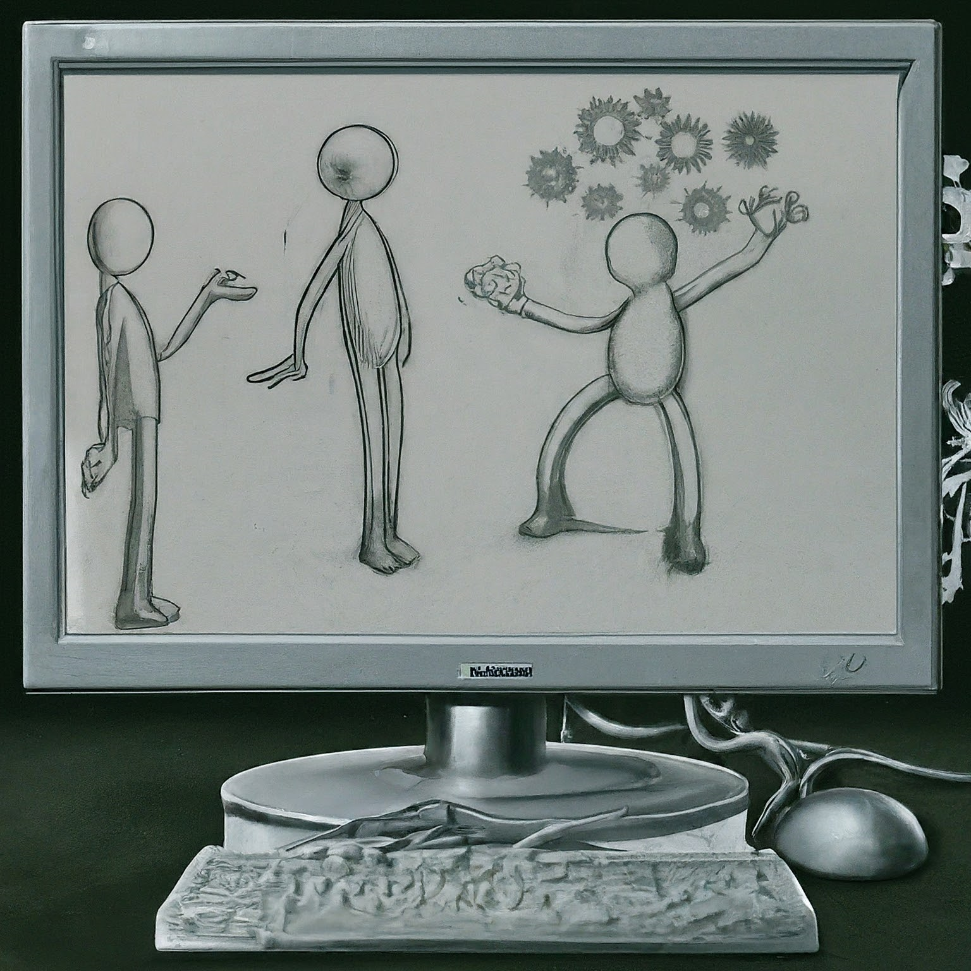
Goals:
Provide conceptual understanding
Demystify some of underlying math
Help build your own mental model to better troubleshoot issues you may encounter in your own unmixing adventures
Generated by David Rach with Bard, a large language model from Google AI.
Prompt: Computer thinking about how to draw a human.

Slide 8
A spectral cytometer needs three things
for successful unmixing:
Full-stained Samples
Single-color
Reference Controls
Unstained
Reference Controls

Slide 9

Let’s go back to the beginning
Generated by David Rach with Bard, a large language model from Google AI.
Prompt: Lego person jumping into the Back to the Future delorean.
Unmixing: It's not magic! © 2024 by David Rach
is licensed under CC BY-SA 4.0

Slide 10
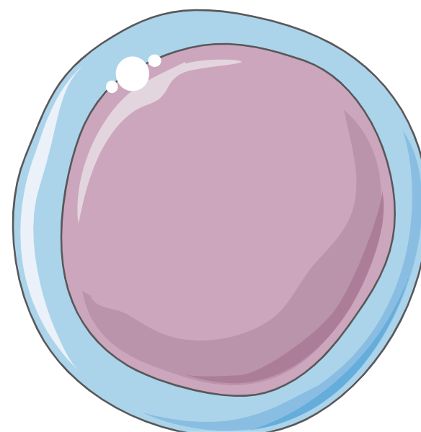
In our tube, we have a cell

Slide 11
With some autofluorescent molecules

Slide 12
Our Aurora shines a laser at it
Excitation

Slide 13
The cells molecules emit signal back
Excitation
Emission

Slide 14
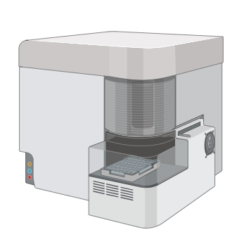
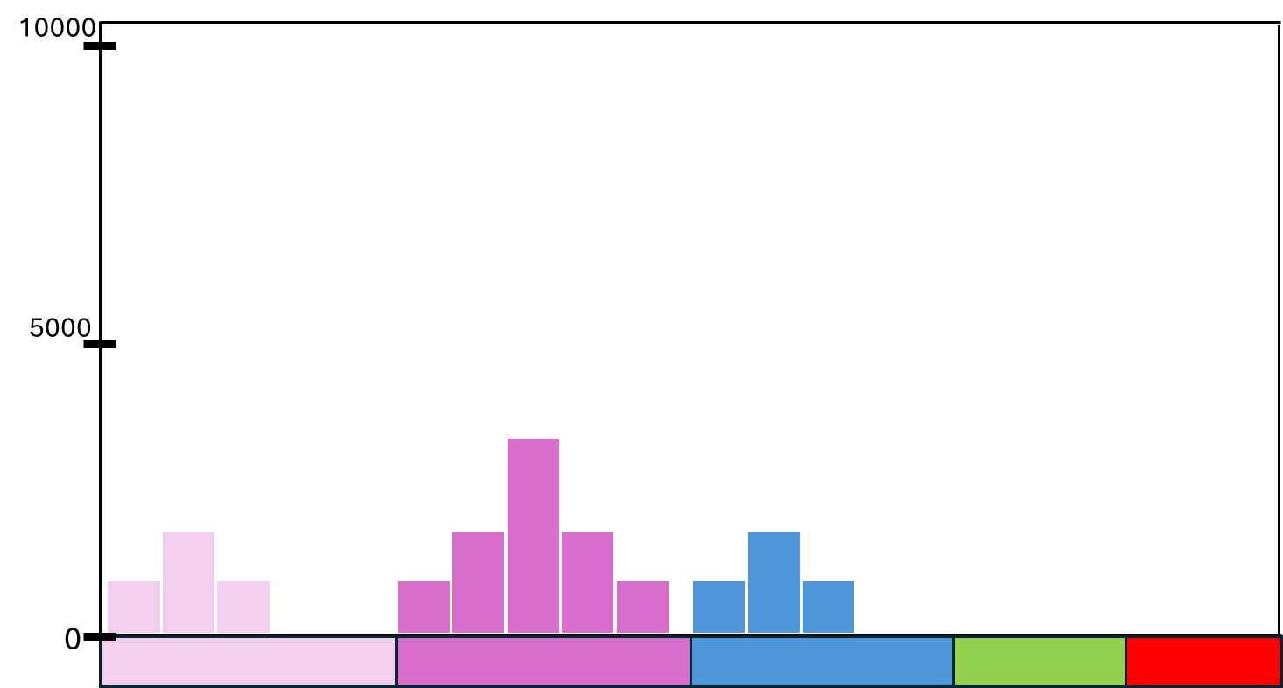
Signal is captured across the various detectors
Excitation
Emission

Slide 15
Raw Signal
10000
5000
0

Slide 16
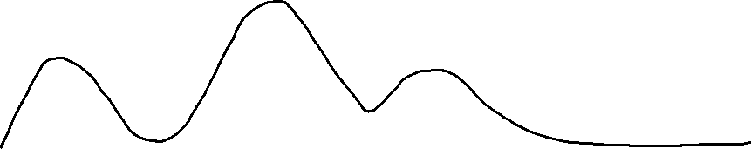
Raw Signal
10000
5000
0
Unmixing: It's not magic! © 2024 by David Rach
is licensed under CC BY-SA 4.0

Slide 17
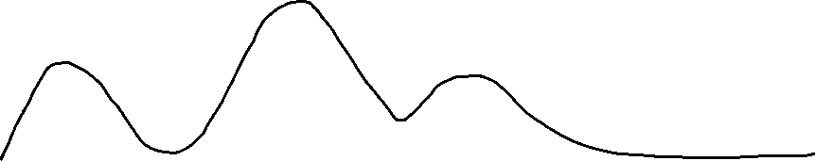
Raw Signal
10000
5000
MFI:4000
0

Slide 18
What if there were twice as many autofluorescent molecules?
?

Slide 19
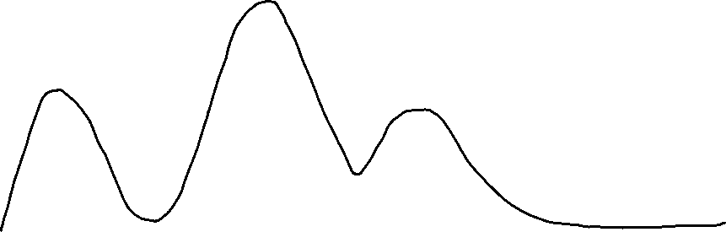
An increase in signal brightness
10000
5000
0

Slide 20
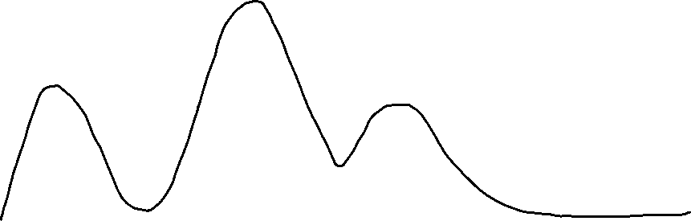
An increase in signal brightness
10000
MFI:6000
5000
0

Slide 21
What if we increased the autofluorescent molecules again?!?
?

Slide 22
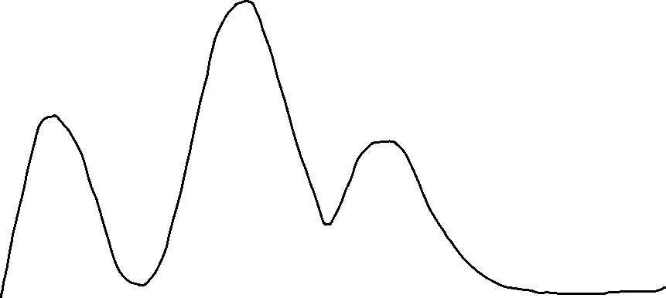
An even brighter signal!
10000
5000
0

Slide 23
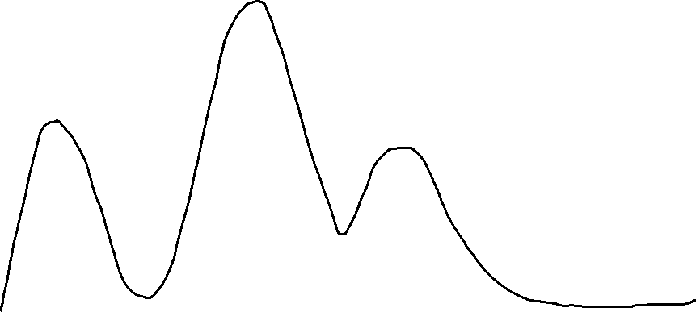
An even brighter signal!
10000
MFI:8000
5000
0

Slide 24
First essential idea: Brightness
10000
5000
0

Slide 25
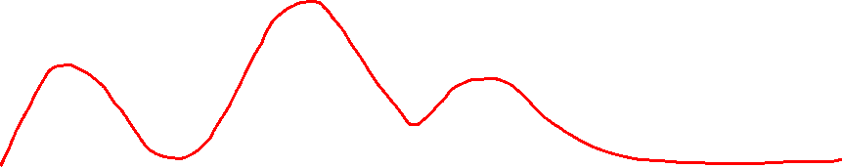
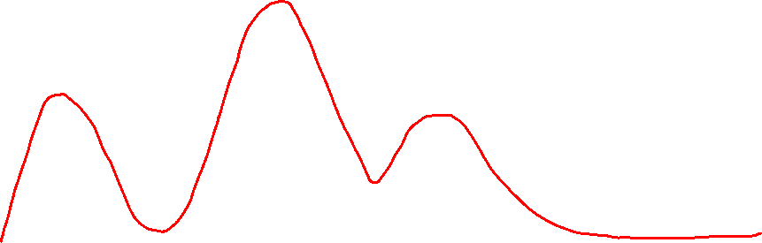
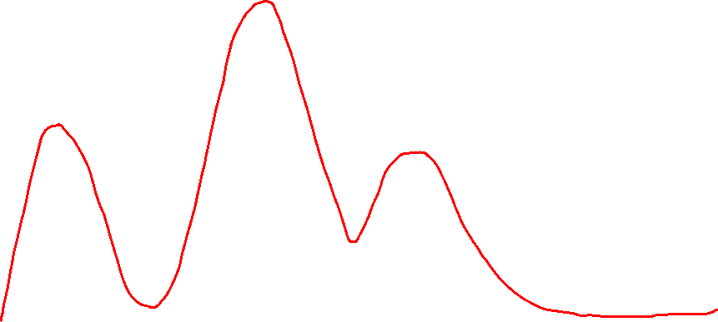
As we record more cells
10000
5000
0

Slide 26
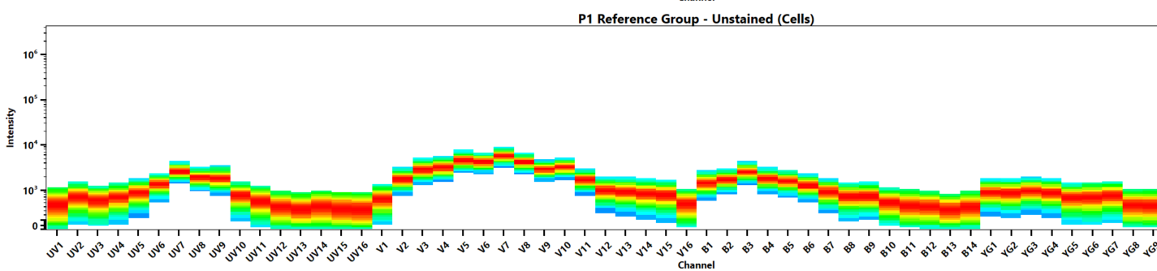
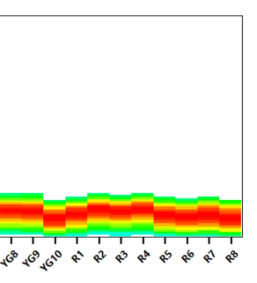
Accounting for density
10000
5000
0

Slide 27
And transforming to a logarithmic axis
10x6
10x5
10x4
10x3
0

Slide 28
Different brightness, but are they the same color?
10000
MFI:8000
MFI:6000
5000
MFI:4000
0

Slide 29
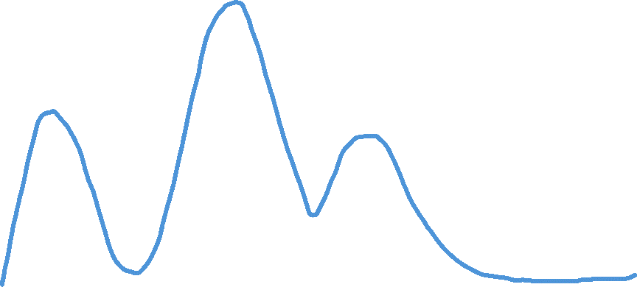
Normalizing/Scaling by Peak Detector
10000
MFI:8000
MFI:5000
MFI:4000
5000
0

Slide 30
Divide each detectors measurement by the
peak detectors measurement
10000
8000/8000 = 1
5000/8000 = 0.625
4000/8000 = 0.5
5000
0

Slide 31
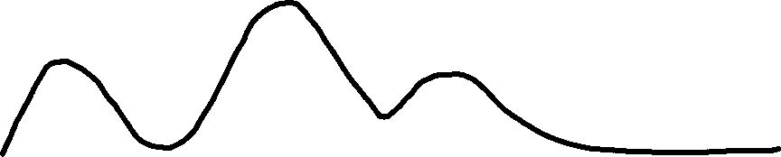
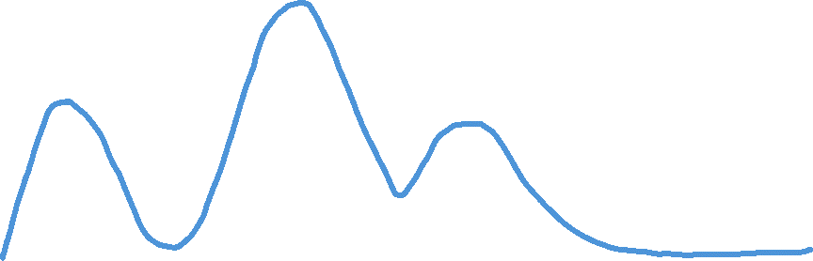
Divide each detectors measurement by the
peak detectors measurement
10000
8000/8000 = 1
5000/8000 = 0.625
6000/6000 = 1
5000
4000/8000 = 0.5
3750/6000 = 0.625
3000/6000 = 0.5
0

Slide 32
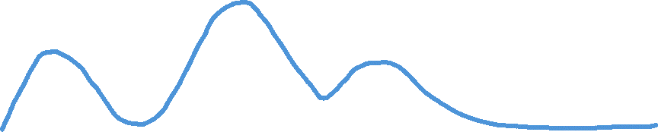
Return the same constants
10000
8000/8000 = 1
5000/8000 = 0.625
6000/6000 = 1
5000
4000/8000 = 0.5
3750/6000 = 0.625
4000/4000 = 1
3000/6000 = 0.5
2500/4000 = 0.625
2000/4000 = 0.5
0

Slide 33
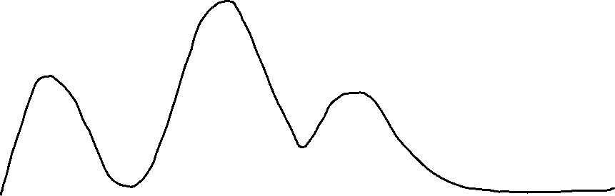
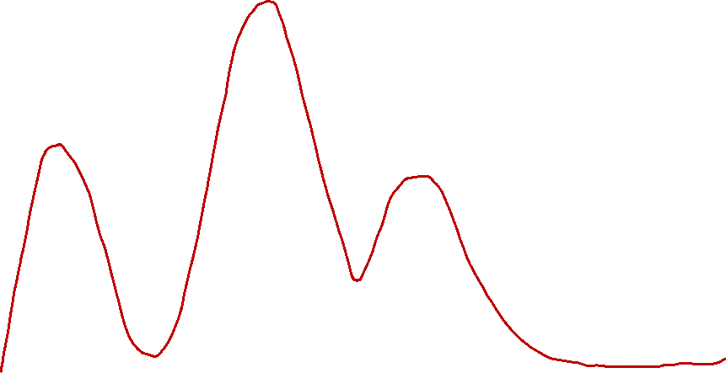
Second essential idea: Signature
100%
50%
0

Slide 34

Second essential idea: Signature
100%
50%
0

Slide 35
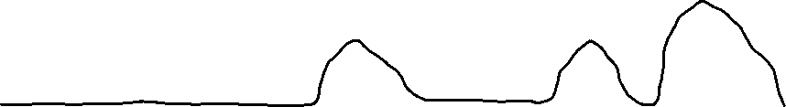
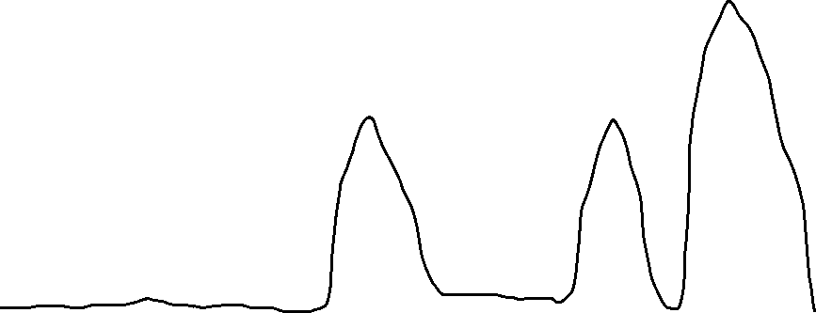
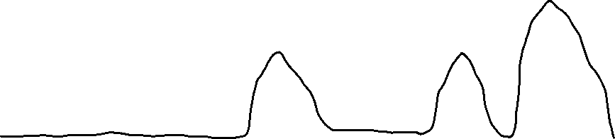
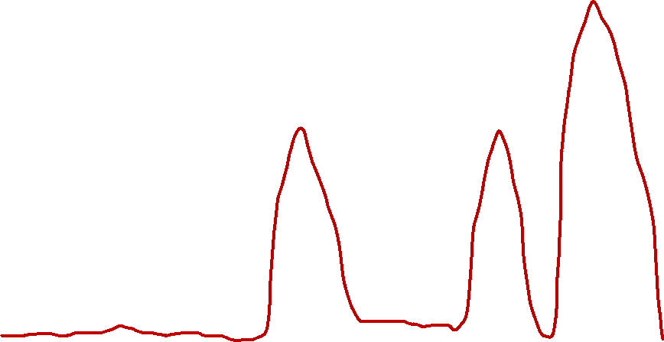
Similar with Fluorophores (APC)
10000
5000
0

Slide 36
Similar with Fluorophores (APC)
100%
50%
0

Slide 37
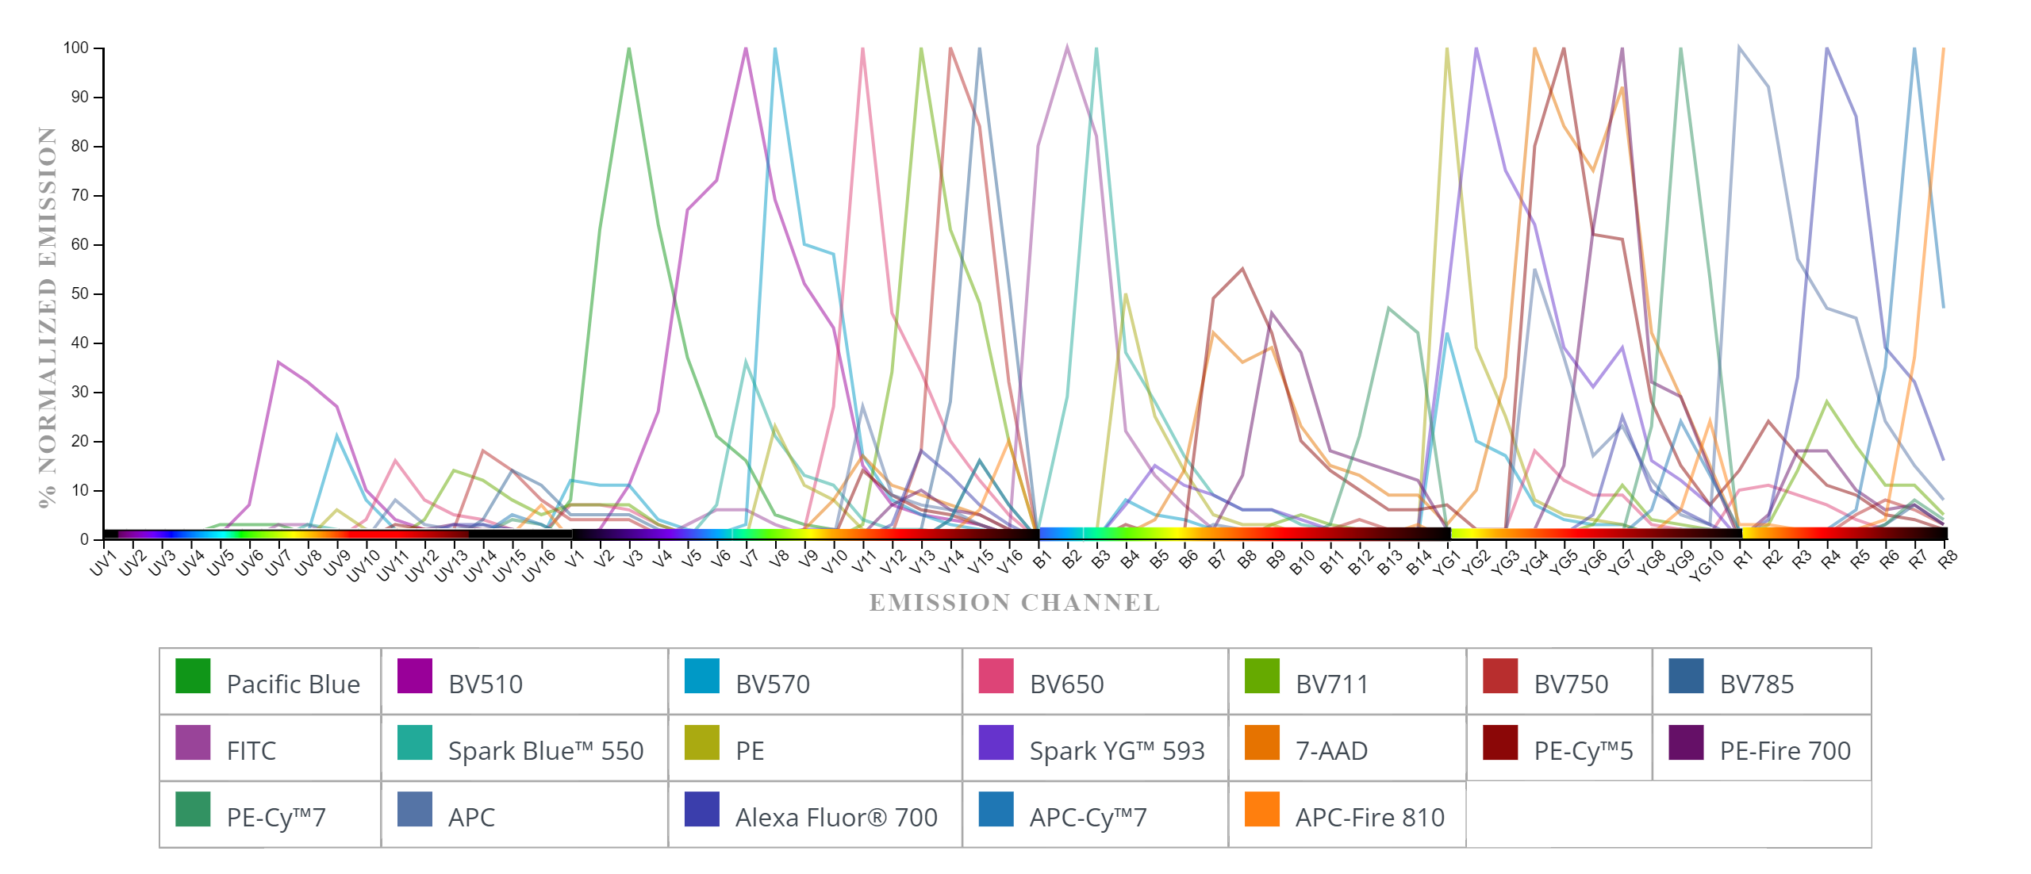
Each Fluorophore has its own characteristic signature

Slide 38
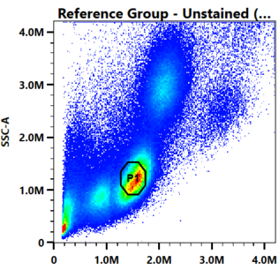
When we gate for Unstained Reference Control
Selects some cells
The gate we draw
Unstained
Reference Controls

Slide 39
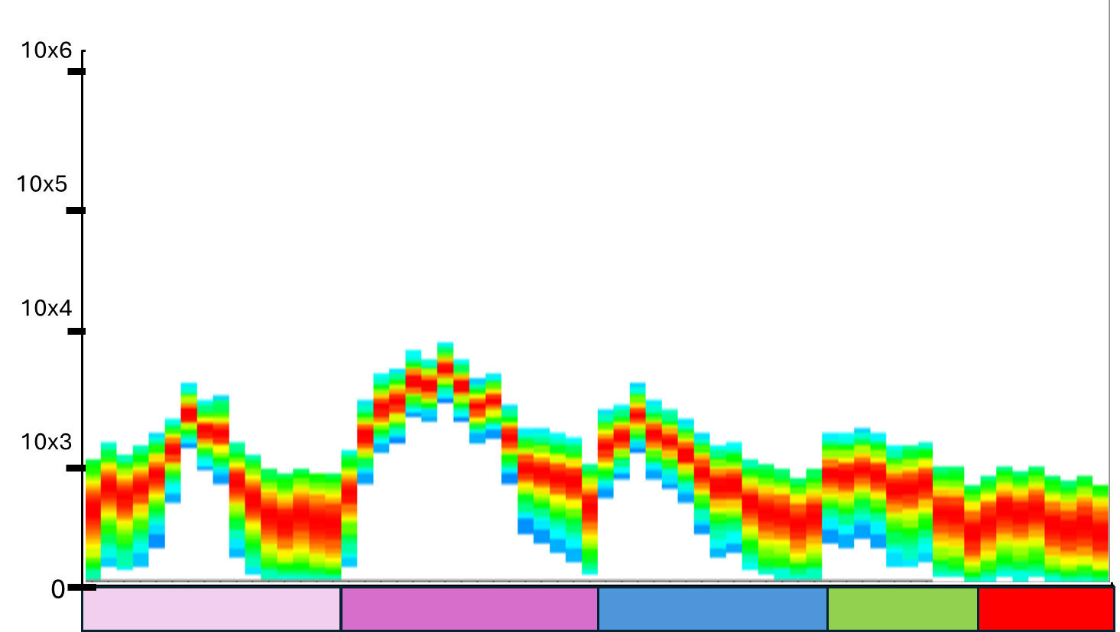
When we gate for Unstained Reference Control
Selects some cells
The median measurement per detector is taken
The gate we draw
Unstained
Reference Controls

Slide 40
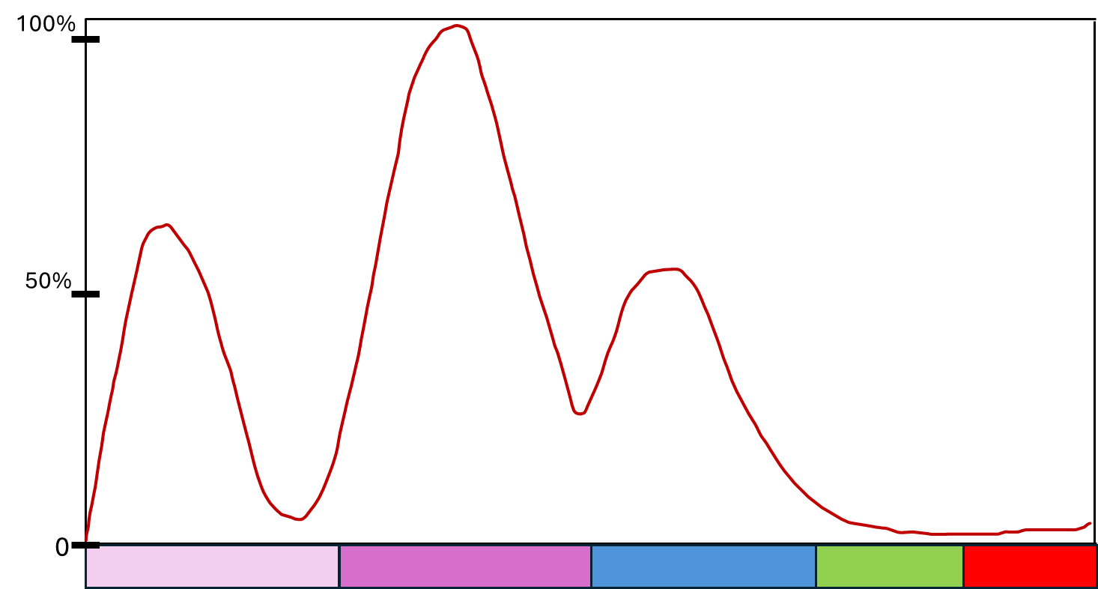
When we gate for Unstained Reference Control
Selects some cells
The median measurement per detector is taken
The gate we draw
Unstained
Reference Controls
And used to generate the reference autofluorescent signature

Slide 41
A spectral cytometer needs three things
for successful unmixing:
Unstained
Reference Controls

Slide 42

A spectral cytometer needs three things
for successful unmixing:
Single-color
Reference Controls
Unstained
Reference Controls

Slide 43
When we gate for Single-color Controls

Slide 44
When we gate for Single-color Controls
These
gated
cells
Make up both the
positive and
negative peaks

Slide 45
When we gate for Single-color Controls
These
gated
cells
Make up both the
positive and
negative peaks
Is your x-axis
The selected detector

Slide 46
When we gate for Single-color Controls
These
gated
cells
Make up both the
positive and
negative peaks
The cells within the positive gate
Is your x-axis
The selected detector
Make up the displayed signature

Slide 47
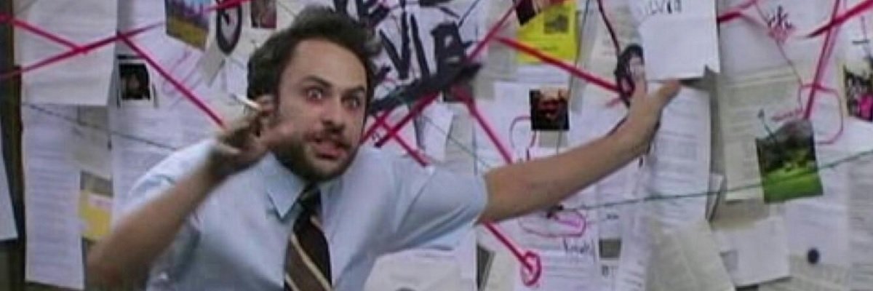
And if that wasn’t enough…

Slide 48
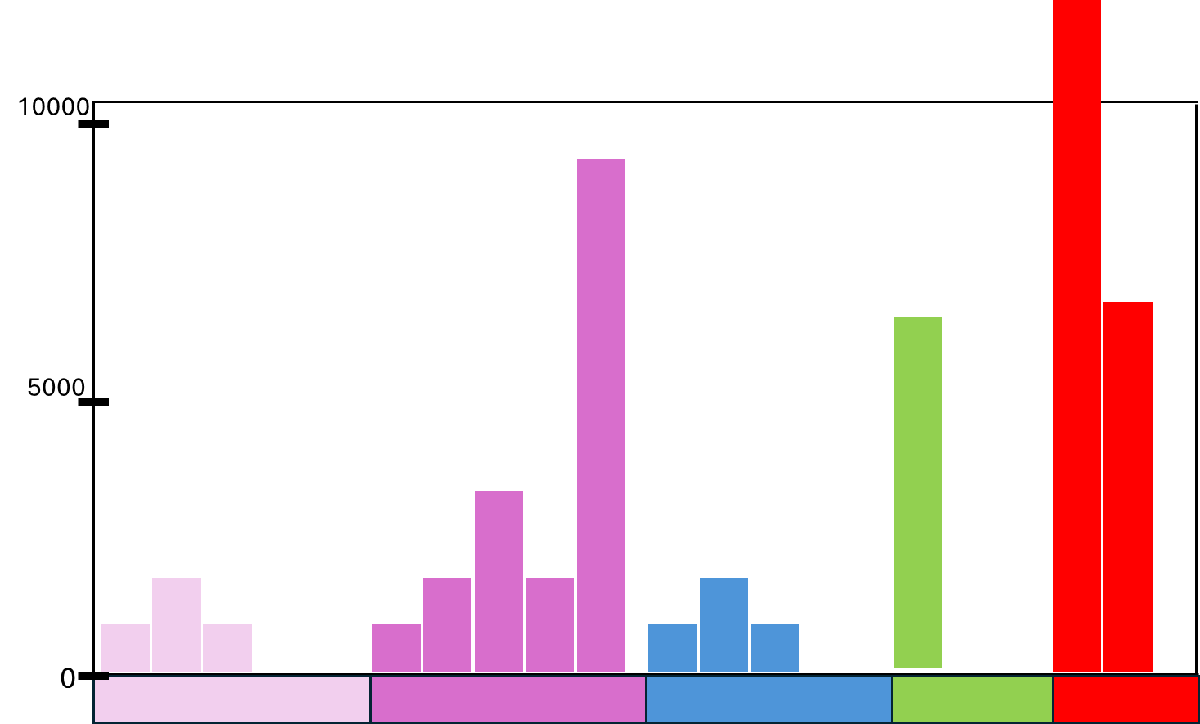
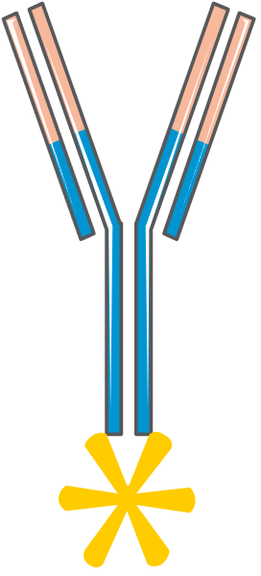
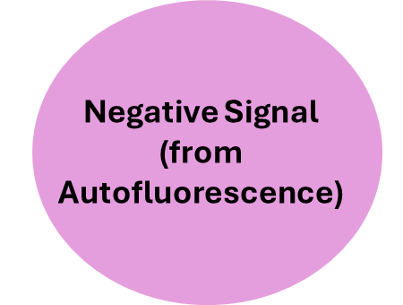
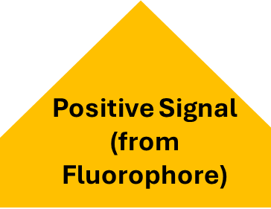
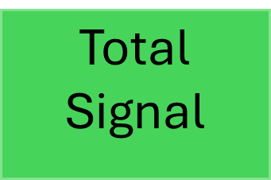
The signal coming from the positive gate in
our single-color controls is a mixture
=
+

Slide 49
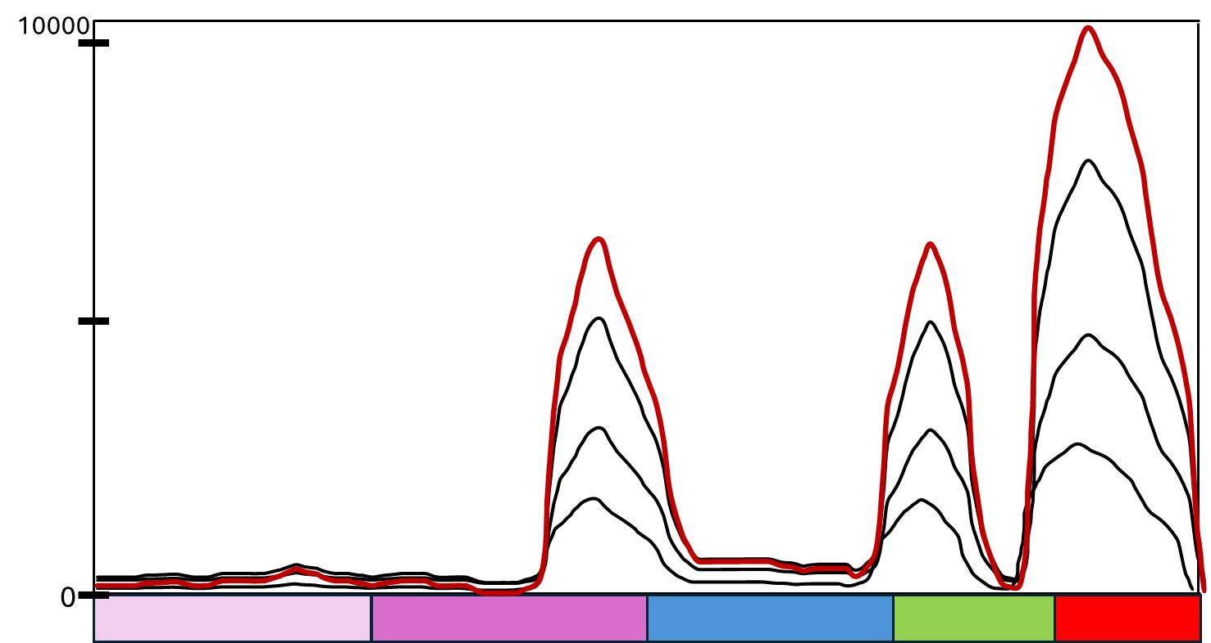
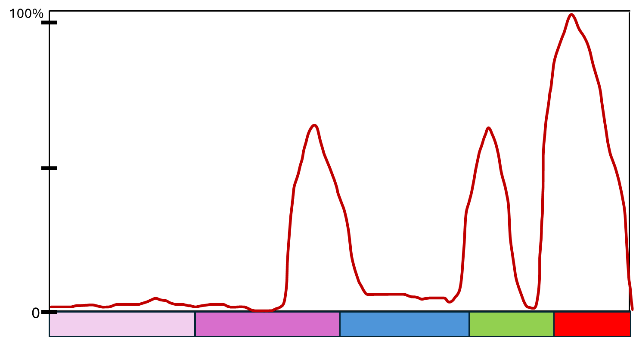
Essential concepts:
Brightness
Signature

Slide 50
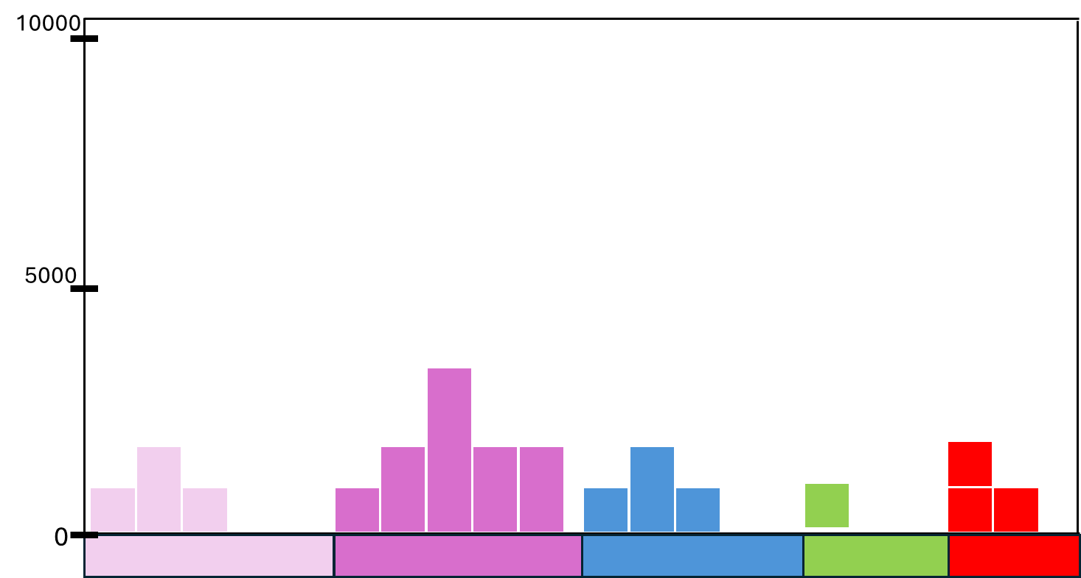

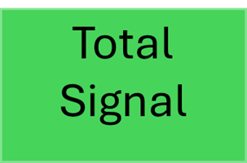
How do we isolate the Fluorophore signature?

Slide 51

How do we isolate the Fluorophore signature?

Slide 52
How do we isolate the Fluorophore signature?
-
= ?

Slide 53
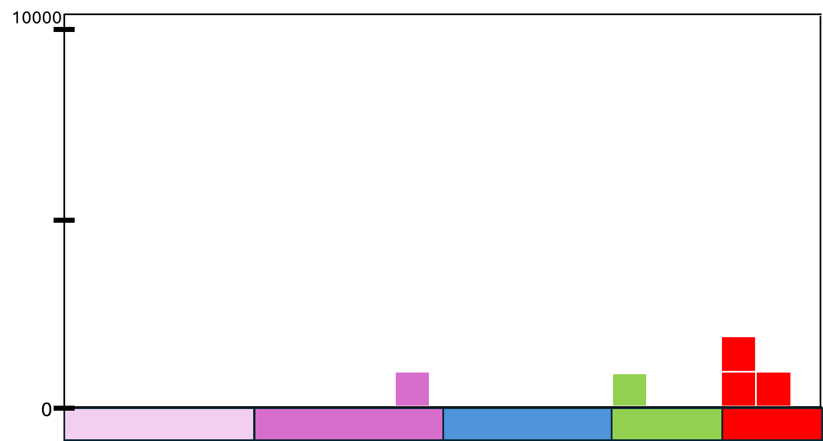


How do we isolate the Fluorophore signature?

Slide 54
What happens with increased autofluorescence?
?

Slide 55
What happens if we increase
fluorophore staining?!?

Slide 56
Very Low

Slide 57



Low

Slide 58



Medium

Slide 59


High

Slide 60




























When autofluorescence is correctly subtracted

Slide 61
When autofluorescence is correctly subtracted
The Fluorophores signature is the same regardless of brightness

Slide 62
The issue: Variation in autofluorescence
Difference in cell size:
Same proportion of autofluorescent molecules, but because one cell is larger, more of them overall, thus brighter
Difference in amount of autofluorescence:
Same cell size, just one has more autofluorescent molecules, thus brighter
Variation in autofluorescent molecules:
Same cell size, but express different mixture of autofluorescent molecules, resulting in a different autofluorescent signature

Slide 63














On dim-staining cells:

Slide 64

Dim-staining cell: with correct autofluorescence subtraction

Slide 65

Dim-staining cell: with missed autofluorescence subtraction

Slide 66


















On bright-staining cells:

Slide 67











Bright-staining cell: with correct autofluorescence subtraction

Slide 68




Bright-staining cell: with missed autofluorescence subtraction

Slide 69


Why would there be leftover autofluorescence signal?

Slide 70
Why would there be leftover autofluorescence signal?
The median measurement from your unstained cells is used.
Example:
UV7 = 2000
V7 = 4000
B3 = 2000

Slide 71
At the population level, not everything is “average”
Our “average”
autofluorescent cell
for the entire population
UV7 = 2000
V7 = 4000
B3 = 2000
Within our single-color reference controls, individual cells may have differences in their expression of autofluorescence molecules.
UV7 = 1000
V7 = 2000
B3 = 1000
UV7 = 2000
V7 = 4000
B3 = 2000
UV7 = 4000
V7 = 8000
B3 = 4000

Slide 72
Leftovers after autofluorescence subtraction
UV7 = 1000
V7 = 2000
B3 = 1000
-
UV7 = 2000
V7 = 4000
B3 = 2000
=
UV7 = -1000
V7 = -2000
B3 = -1000
UV7 = 2000
V7 = 4000
B3 = 2000
-
UV7 = 2000
V7 = 4000
B3 = 2000
=
UV7 = 0
V7 = 0
B3 = 0
UV7 = 4000
V7 = 8000
B3 = 4000
-
UV7 = 2000
V7 = 4000
B3 = 2000
=
UV7 = +2000
V7 = +4000
B3 = +2000

Slide 73




Adventures in Real World Data
(from my recent experiment)

Slide 74






Substantial leftover autofluorescence affecting signature for
dim marker*fluorophore combinations

Slide 75



Be cautious when using cell controls for dim fluorophores or tertiary markers
Split the gated cells into 10 groups by percentile, subtracted autofluorescence, and then normalized

Slide 76
Be cautious when using cell controls for dim fluorophores or tertiary markers
Split the gated cells into 10 groups by percentile, subtracted autofluorescence, and then normalized
Increasing leftover autofluorescence as
you gate further left

Slide 77


In terms of the fluorophore signature used for unmixing

Slide 78



In terms of the fluorophore signature used for unmixing
When gating single-color controls, the brightest staining cells are more resilient to signature changes due to leftovers

Slide 79

One major exception: Antibody aggregates!
Figure from Laura Johnston (formerly University of Chicago) wonderful blogpost! https://voices.uchicago.edu/ucflow/2020/09/30/how-to-identify-bad-flow-cytometry-data-part-1/

Slide 80



One major exception: Antibody aggregates!
-
=

Slide 81

Not all problems are due to autofluorescence

Slide 82

Your fluorophores can also vary in
their signature!!!
Manufacturer Lot Variation
Cross-pollinating BUV and BV fluorophores
Tandem degradation
FRET
And others!
But that’s a problem for Thursday’s Single Color and Autofluorescence Troubleshooting session.

Slide 83


For now: The three rules for good unmixing controls
The single stained control must be as bright or brighter than the fully stained sample.
The exact same fluorophore must be used the stain the control and the fully stained sample.
Background autofluorescence should be the same for the positive and negative control
Previewing Thursday’s
session
https://voices.uchicago.edu/ucflow/flow-cytometry-resources/

Slide 84
A spectral cytometer needs three things
for successful unmixing:
Single-color
Reference Controls
Unstained
Reference Controls

Slide 85

A spectral cytometer needs three things
for successful unmixing:
Single-color
Reference Controls
Unstained
Reference Controls

Slide 86


Every reference control provides an unique signature
Then what happens?

Slide 87
Each unique signature becomes a reference vector
10000
5000
0
3
6
3
0
0
3
6
9
6
3
3
6
3
0
0
0
0
0
0
0
0

Slide 88
Each unique signature becomes a reference vector
10000
5000
0
3
6
3
0
0
3
6
9
6
3
3
6
3
0
0
0
0
0
0
0
0

Slide 89
Each unique signature becomes a reference vector
3
6
3
0
0
3
6
9
6
3
3
6
3
0
0
0
0
0
0
0
0

Slide 90
Wait a second…. Vector…

Slide 91
It’s not magic….

Slide 92

It’s math!
1) Raw Data
2) Linear Algebra
3) Unmixed Data

Slide 93
It’s math!
1) Raw Data
2) Linear Algebra
3) Unmixed Data
Which for biologist might as well be magic

Slide 94
So lets try to demystify some of underlying math
0
0
0
0
0

Slide 95



A two-detector vector
=
+
3
4
1
0
0
2

Slide 96



Finding a linear combination of Blue and Green that gives us the total
=
+

Slide 97
Finding a linear combination of Blue and Green that gives us the total
=
+
3

Slide 98
Finding a linear combination of Blue and Green that gives us the total
=
+
2
3

Slide 99
Viewed differently:

Slide 100
Viewed differently:
x
3

Slide 101
Viewed differently:
3
x
2
x

Slide 102




A three-detector vector
=
+
+

Slide 103
A three-detector vector
=
3
+
2
+
1

Slide 104
Where David’s Art Skills End
3
4
5

Slide 105
Lines (or planes) flying through space
3
4
5

Slide 106
Also explains: Presence or Absence
=
3
0
0
+
2
+
1

Slide 107
Beyond three-dimensions
=
+
+
Each New Fluorophore
Signature
+

Slide 108
Final Math Details:
In the above examples, we had the same number of detectors as fluorophores. The matrix generated by collecting the signatures from your single-color controls is a square. This is the case with conventional Flow Cytometry.
In Spectral Flow Cytometry, we have more detectors than Fluorophores. The matrix generated by collecting the signatures from your single-color controls is a rectangle. This is called an overdetermined system. With rare exceptions, these can’t be solved exactly.
However, they can be approximated, which is where some variation of least-square algorithm is used (ordinary least squares in SpectroFlos case)

Slide 109



If you want to learn more:

Slide 110
A spectral cytometer needs three things
for successful unmixing:
Single-color
Reference Controls
Unstained
Reference Controls

Slide 111
Unmixing’s Quandaries
Each cell in your full-stained sample is unmixed individually…
Presence (or absence) of each Fluorophore
Relative expression of each Fluorophore

Slide 112
Unmixing’s Quandaries
Each cell in your full-stained sample is unmixed individually…
Presence (or absence) of each Fluorophore
Relative expression of each Fluorophore
By referencing the unique signatures
from the unstained & single-color reference controls…
Which are derived from taking the mean/median fluorescence measurement of a gated population of reference cells…
….after first subtracting out background autofluorescent signature based on a gated population of unstained cells.

Slide 113
Unmixing’s Quandaries
Each cell in your full-stained sample is unmixed individually…
Presence (or absence) of each Fluorophore
Relative expression of each Fluorophore
By referencing the unique signatures
from the unstained & single-color reference controls…
Which are derived from taking the mean/median fluorescence measurement of a gated population of reference cells…
….after first subtracting out background autofluorescent signature based on a gated population of unstained cells.
Variation here will
impact your unmixing results

Slide 114
For now: The three rules for good unmixing controls
The single stained control must be as bright or brighter than the fully stained sample.
The exact same fluorophore must be used the stain the control and the fully stained sample.
Background autofluorescence should be the same for the positive and negative control
https://voices.uchicago.edu/ucflow/flow-cytometry-resources/

Slide 115

Questions?

